Slide 1
Kezzel
Run
Mark Spector
Jacob Miller
Coy Korak
Bryson Lindsay
Chris Dennis
TEAM APPLE TOO

Slide 2
What is “Kezzel Run”?
It’s not Asteroids
It’s a roguelike
It’s progression It’s speed

Slide 3
Who?
What?
Where?
The player is a space courier
who races cargo
through the most dangerous stretch of the galaxy.

Slide 4
Moving the ship on a 2D plane
Shooting weapons
Destroying asteroids
Collecting credits
Buying weapons/items
Obstacles to avoid to facilitate challenge
A ship to control to facilitate sensation
Weapons to fire to facilitate sensation
Upgrades to buy to facilitate expression
Sensation
Challenge
Expression
Fantasy
NON-IMMERSIVE

Slide 5
Moving the ship in a 3D plane
Shooting weapons
Destroying asteroids
Collecting credits
Buying weapons/items
Obstacles to avoid to facilitate challenge
A ship to control to facilitate sensation
A first person view to facilitate sensation
Weapons to fire to facilitate sensation
Upgrades to buy to facilitate expression
Sensation
Challenge
Expression
Fantasy
AUGMENTED REALITY

Slide 6
Technical Challenges
Scripting game logic and mechanics using Unity and Visual Studio
Designing a mobile game UI
Implementing touchscreen controls
Creating 3D models using Blender
Creating music and sound effects

Slide 7
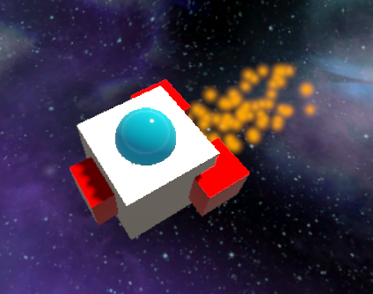
The Prototype

Slide 8

Footage of Game in Unity

Slide 9
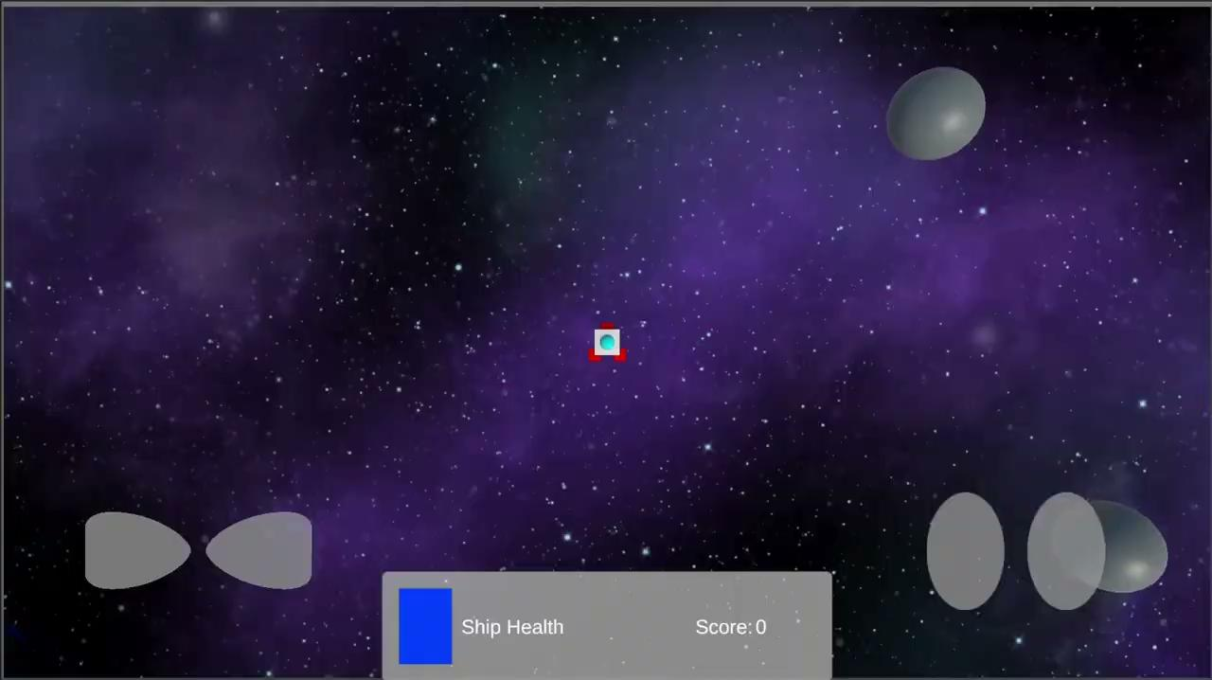
Footage of Game in Unity

Slide 10
Footage of Game in Blender

Slide 11
Sound Design
Retro Style Music and Sound Effects
Shooting and explosion sound effects
3 different songs, 1 for title screen, 1 for in game, and 1 left for ending screen or as back up use
Title song is upbeat
Ingame song is all around and nonstop
The last song is more melancholy and sad

Slide 12
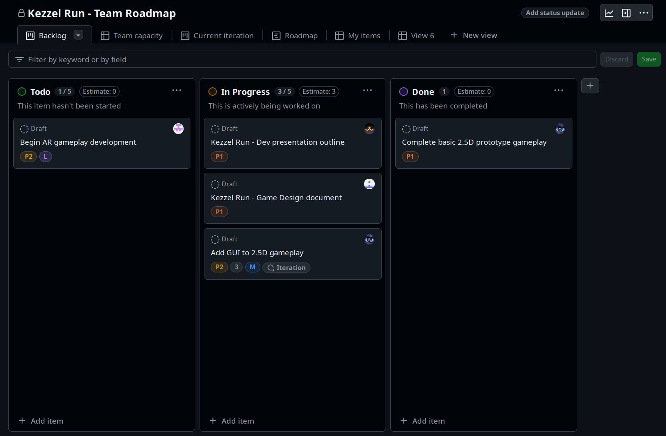
Our Schedule
We are using
Github’s Issues and Projects features to manage our schedule.

